Slide 1
UTS 43001 · CYBERSECURITY CHALLENGE STUDIO
Cloud Exploitation & Building a
Secure Cloud Storage Service
The SnapVault project. Attack it, then lock it down.
WEAK
HARDENED
Aziz Almehmadi · Abdulrahman Albrahim · Nawaf Alanazi

Slide 2
How the project works
Most cloud breaches come from misconfiguration, not clever exploits, so we show both the break and the fix.
1
Learn
Work the HTB Cloud Exploitation track (8 machines), with a root cause and fix for each.
2
Build
SnapVault is one weak build and one hardened build. Same app, same attack.
3
Guide
Turn the fixes into a developer guideline anyone can follow.
4
Demo
An AI agent replays the attack. The weak build falls in about 2 minutes, the hardened one holds.
5
Next
An AI pentest agent developers can run against their own cloud service.

Slide 3
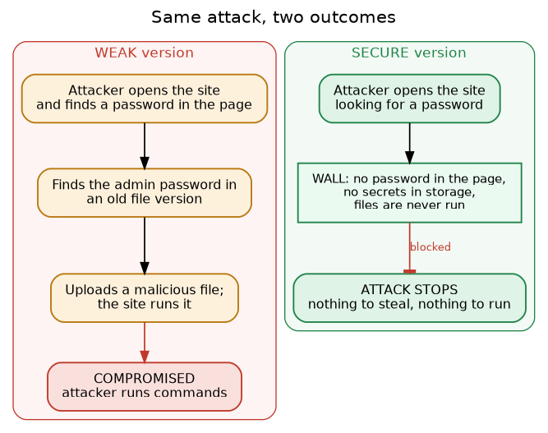
Same attack, two outcomes
SnapVault is a small file-sharing app on MinIO (S3-style storage), built twice.
Weak build
The attack chain runs to the end, and the attacker reaches code execution on the server.
Hardened build
The identical attack dies at the very first move. Nothing to steal, nothing to run.

Slide 4
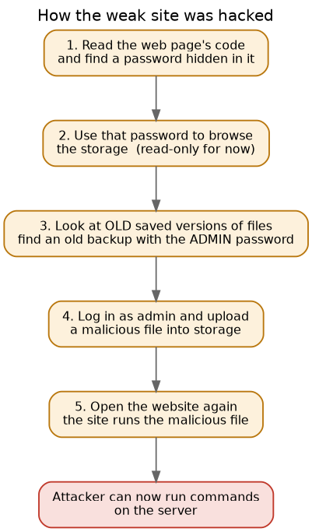
How the weak build falls
One chain, built entirely from small, real misconfigurations we met on the HTB track.
A secret in the page
A read-only key is left hardcoded in the site's JavaScript.
An old backup in storage
An old object version still holds the admin credentials that were meant to be deleted.
A file the server will run
A PHP webshell is written into the bucket, which the app mirrors and executes.
Chained together, three small mistakes reach code execution. The same pattern we saw on Bucket, Epsilon and Gobox.

Slide 5
Why the hardened build holds
Defence in depth. Six independent controls, and any one of them breaks the whole chain.
C1
No secrets in the page
C2
Scoped app key
C3
No old secrets
The frontend carries no key, so step 1 has nothing to find.
One tightly scoped account that can't browse or escalate.
Versioning is off and the key can't list versions, so there's nothing to recover.
C4
Safe uploads only
C5
Files are never run
C6
App runs non-root
Only allow-listed file types with random names, so a shell.php is rejected.
Objects stream back as downloads, so a stored file can't become a running one.
Non-root with a read-only filesystem, so even code execution lands nowhere.
These six controls became our Secure Cloud Environment Developer Guideline.

Slide 6
Showing it with AI
DONE
NEXT
Live demo agent
Pentest agent for developers
Replays the full chain on both builds, side by side.
Weak → code execution in about 2 minutes. Hardened → blocked at step 1.
Locked to the local lab (loopback only) for safety.
Point it at your own cloud storage service.
It runs the same class of checks and reports back where you're exposed, before an attacker finds it.
One command turns the whole weak-vs-hardened story into a two-minute demo.

